Slide 1
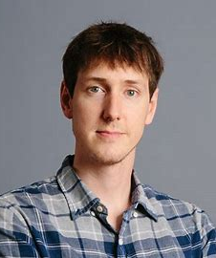
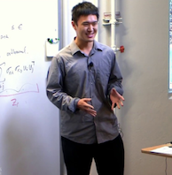
Chasing Convex Bodies
Mark Sellke
Based on JOINT WorkS with:
Sébastien Bubeck, Bo’az Klartag, Yin Tat Lee, Yuanzhi Li, Yuval Rabani

Slide 2
The Convex Body Chasing (CBC) Problem
We receive an online sequence $K_{1},K_{2},…∈ℝ^{d}$ of convex sets.
After seeing $K_{t}$, we (ALG) move to a point $x_{t}∈K_{t}$.
We want to minimize total movement, with $x_{0}$ the origin:
$$Cost_{T}\left(ALG\right)=\sum_{t=1}^{T}{|\left|x_{t}−x_{t−1}\right||}$$
We compare to a benchmark, OPT, the offline optimum who can see the $K_{t}$ in advance.
CBC problem: be competitive. Want $\frac{Cost_{T}\left(ALG\right)}{Cost_{T}\left(OPT\right)}≤α_{d}$ for $α_{d}$ as small as possible.
Randomization does not help for CBC algorithms.
Averaging random paths gives a better, deterministic path.
Means adaptive/oblivious adversaries are equivalent.
$$K_{t}$$
$$x_{t−1}$$
$$x_{t}$$

Slide 3
Example

Slide 4
Example

Slide 5
Example

Slide 6
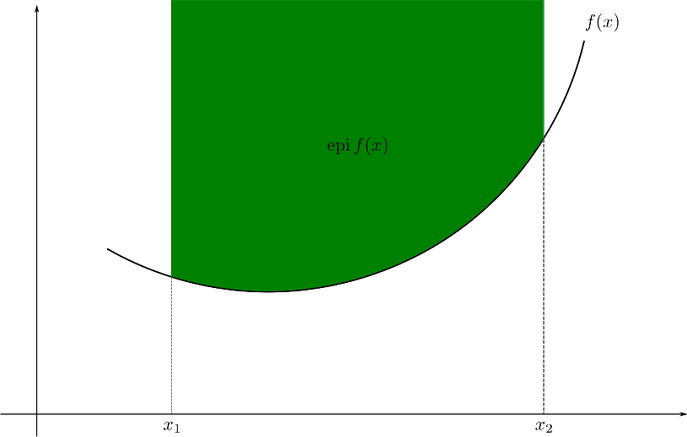
Equivalence With Chasing Convex Functions
Receive convex cost functions $f_{t}:ℝ^{d}→ℝ^{+}.$ P$ick x_{t}$ after seeing $f_{t}$.
Total cost is
$$Cost_{T}\left(ALG\right)=\sum_{t=1}^{T}{\left|\left|x_{t}−x_{t−1}\right|\right|+f_{t}\left(x_{t}\right). }$$
This is chasing convex functions. Again the aim is to compete with OPT.
Chasing convex bodies and functions are equivalent!
Easy to turn a convex set into a convex function: $f_{t}\left(x\right)=d(x,K_{t})$.
Conversely, the epigraph of $f_{t}$is a convex set in d+1 dimensions. Leads to a reduction.

Slide 7
Motivation 1: Online Convex Optimization
If functions $f_{t}$ are 1-Lipschitz, then movement cost upper-bounds the look-ahead advantage:
$$Cost_{T}\left(ALG\right)=\sum_{t=1}^{T}{|\left|x_{t}−x_{t−1}\right||+f_{t}\left(x_{t}\right)}≥\sum_{t=1}^{T}{f_{t}\left(x_{t−1}\right)}.$$
Now it looks like online convex optimization. Lots of work showing regret bounds
$$𝔼\sum_{t=1}^{T}{f_{t}\left(x_{t−1}\right)}−\min_{x}\sum_{t=1}^{T}{f_{t}\left(x\right)=O_{d}\left(\sqrt{T}\right).}$$
Chasing convex functions is the natural analog when the optimum can move, i.e. the world is non-stationary. We aim for a weaker multiplicative guarantee, but against a moving benchmark.
Variations of chasing convex functions have been recently studied in control theory under the name smoothed online convex optimization.

Slide 8
Motivation 2: Metrical Task Systems (MTS)
More general problem: metrical task systems. Also includes k-server. Aim to be competitive moving in a metric space X with some set S of permitted positive cost functions.
Question: how does the competitive ratio depend on X and S?
Randomized competitive ratio in $\left[\frac{log\left(n\right)}{\log\left(\log\left(n\right)\right)},\log^{2}\left(n\right)\right]$ if $\left|X\right|=n$ with unrestricted costs.
([Fiat-Mendel 03], [Bartal-Linial-Mednel-Naor 06], [Bartal-Bollobas-Mendal 06], [Bubeck-Cohen-Lee-Lee 19])
Our problem lives in $X=ℝ^{d}$, an infinite metric space. Will the restriction to convex functions make the competitive ratio finite?

Slide 9
Some Related Work
[Friedman-Linial 93]: First posed CBC as a convex MTS, gave competitive algorithm in $d=2$ dimensions.
$\sqrt{d}$lower bound for Euclidean space, $d$ for $ℓ_{d}^{∞}$ . Both based on faces of hypercube.
Take $K_{t}=\{a_{1}\}×\left\{a_{2}\right\}×…×\left\{a_{t}\right\}×{\left[−1,1\right]}^{d−t}$ for random $a_{i}∈\{±1\}$ and $1≤t≤d$.
[Antoniadis-Barcelo-Hugent-Pruhs-Schewior-Scquizzato 16]: Affine subspaces chasable with competitive ratio $2^{O(d)}$.
[Goel-Wierman 19]: Dimension-independent competitive ratio for squared Euclidean movement cost and strongly convex functions.

Slide 10
Chasing Nested Convex Bodies
Nested CBC:
Start with $K_{1}=B_{1}$ the unit ball.
Receive request sequence $K_{1}⊇K_{2}⊇.. .$ .
Move online to $x_{t}∈K_{t}$.
Aim: Ensure movement at most $α.$
$Cost\left(OPT\right)≤1$ so this is certainly easier than CBC.
Good stepping stone to full problem, related to online LPs.
The main change is $K_{1}⊇K_{2}⊇…$. $K_{1}=B_{1}$ is WLOG via double-and-restart.
$${\tilde{K}}_{t}$$
$$2^{n+1}$$
$$K_{t}$$
$$x_{0}$$
$$2^{n}$$

Slide 11
Centroid Approach of [ABCGL 19]
For nested chasing: keep $x_{t}$ in the middle of $K_{t}.$ When we have to move, $K_{t}$shrinks a lot.
Precisely: If $x_{t}$ is the center of gravity $cg(K_{t})$, then every request forcing movement shrinks the volume by a constant factor (Grunbaum’s inequality).
Hope: every $O(d)$ steps the diameter halves, hence $O(d)$ movement.
Doesn’t work. Thin approximate-triangles have very sensitive centroid:
Fix: recursively define orthogonal long/short subspaces. Only move in short subspace if possible.
Short
Long

Slide 12
Results From Centroid Approach
[Argue-Bubeck-Cohen-Gupta-Lee 18]: $\tilde{O}\left(d\right)$ for nested chasing in any norm.
[Bubeck-Klartag-Lee-Li-S 18]: $\tilde{O}\left(\sqrt{d}\right)$ for nested chasing in $ℓ^{2}$, nearly optimal $\tilde{O}\left(d^{\max\left(\frac{1}{2},1−\frac{1}{p}\right)}\right)$in $ℓ^{p}$. Use centroid of a Gaussian restricted to $K_{t}$.
[Bubeck-Lee-Li-S 18]: $2^{O\left(d\right)}$ competitive ratio for non-nested chasing.
Break into phases. Treat the (convex) set of low-movement locations in each phase as a nested problem.
Recursion on scale and dimension is more complicated and leads to exponential dimension dependence.
Takeaway: Centroid works great for nested chasing. For the full problem, the resulting induction on dimension works but is rather crude.

Slide 13
Steiner Point
Steiner point: a beautiful selector choosing a point $s\left(K\right)∈K$ for any convex set $K$.
[Przesławski-Yost 89]: $s(K)$ has the exact minimum Hausdorff-Lipschitz constant among selectors in $ℓ_{d}^{2}$ which is $Θ\left(\sqrt{d}\right).$
[Bubeck-Klartag-Lee-Li-S 18]: for nested chasing in $ℓ^{2}$, Steiner point has competitive ratio exactly $d$.
Moreover, with $T$ requests, nearly optimal competitive ratio $O(\sqrt{d⋅log⁡(T)} )$.
In fact, for any fixed $(d,T)$ Steiner point is the exact optimal memoryless algorithm in some sense.
[S 19]: Functional Steiner Point of the work function achieves competitive ratio $d$ in any normed space, and $O(\sqrt{d⋅log\left(T\right)})$ in Euclidean space. This is exactly tight for $ℓ^{∞}.$ Similar result in [Argue-Gupta-Guruganesh-Tang 19].
Notes:
But what is the Steiner Point?

Slide 14
Primal Definition of Steiner Point
$s\left(K\right)=\int_{\left|v\right|<1}{f_{K}\left(v\right)dv}$. $f_{K}\left(v\right)=argmax_{x∈K}⟨x,v⟩$
$$v$$
Any nonzero $v$ is in the normal cone of some extreme point $f_{K}(v)$ of K.
$s(K)\text{=}𝔼[f_{K}\left(v\right)]$ with $v∈B_{1}$ uniformly random.
$f_{K}\left(v\right)∈K$ for all $v$, therefore $s\left(K\right)∈K$ by convexity.
$f_{K}$ is homogenous so could take $\left|v\right|=1$ on the sphere. Sphere vs ball matters later.
$$f_{K}\left(v\right)$$
$$s(K)$$

Slide 15
Dual Definition of Steiner Point
$$s\left(K\right)=d⋅\int_{\left|θ\right|=1}{h_{K}\left(θ\right)θdθ; }h_{K}\left(θ\right)=\max_{x∈K}{ \left\langle x,θ\right\rangle ={⟨f}_{K}\left(θ\right),θ⟩}$$
Similar to primal, but:
1. Choose $\left|θ\right|=1$ instead of $\left|v\right|≤1$.
2. Project $f_{K}\left(θ\right)$ onto $θ$ (resulting in $h_{K}\left(θ\right)θ$) before averaging.
3. Multiply by $d$ after averaging.
$h_{K}\left(⋅\right)$ is the support function of K. Two properties:
1. $K⊆K′$ iff $h_{K}\left(v\right)≤h_{K^{′}}(v)$ for all $v$.
2. Hausdorff distance $d_{H}\left(K,K^{′}\right)$between convex $K,K^{′}$ is$|\left|h_{K}−h_{K^{′}}\right||_{L^{∞}(B_{1})}$.
$$d_{H}\left(K,K^{′}\right):={\inf{\{r>0:K⊆K^{′}+B_{r}⊆K+B_{2r}\}}}=|\left|h_{K}−h_{K^{′}}\right||_{L^{∞}(B_{1})}$$
$$θ$$
$$h_{K}\left(θ\right)θ=⟨f_{K}\left(θ\right),θ⟩θ$$
$$f_{K}\left(θ\right)$$
$$(0,0)$$

Slide 16
Recap of Two Definitions
Definition ([Steiner 1840]): the Steiner point $s\left(K\right)∈K$ of a convex set $K∈ℓ_{d}^{2}$ is:
$$s\left(K\right)=\int_{\left|v\right|<1}{f_{K}\left(v\right)dv=d⋅\int_{\left|θ\right|=1}{h_{K}\left(θ\right)θ dθ}}.$$
Both integrals are normalized to be expectations over the unit ball/sphere in $ℝ^{d}$. And:
$$f_{K}\left(v\right)=\underset{x∈K}{argmax}\left\langle x,v\right\rangle ,{ h}_{K}\left(θ\right)=\max_{x∈K}{ \left\langle x,θ\right\rangle ={⟨f}_{K}\left(θ\right),θ⟩.}$$
First definition is primal: $f_{K_{t}}\left(v\right)∈K_{t}$ implies $s\left(K_{t}\right)∈K_{t}$ by convexity.
Second definition is dual: used to upper bound total movement.
Support Function
(Scalar)
Extreme Point (Vector)

Slide 17
Why Do The Definitions Agree?
$$s\left(K_{t}\right)=\int_{\left|v\right|<1}{f_{K_{t}}\left(v\right)dv=d⋅\int_{\left|θ\right|=1}{h_{K_{t}}\left(θ\right)⋅θdθ}}$$
$$f_{K}\left(v\right)=\underset{x∈K}{argmax}⟨x,v⟩, h_{K}\left(θ\right)=\max_{x∈K}{ \left\langle x,θ\right\rangle ={⟨f}_{K}\left(θ\right),θ⟩.}$$
Key point: $f_{K}=∇h_{K}$. Also $θ=\hat{n}(θ)$ is the outward normal to the sphere at $θ$.
General Gauss-Green Theorem (variant of Divergence Theorem):
$$\int_{U}{∇h\left(v\right)dv=\int_{∂U}{h\left(v\right)⋅\hat{n}\left(v\right)dv.}}$$
Factor $d$ is ratio of total measure for ball vs sphere – integrals are normalized.
Both sides compute $∇_{x}\int_{U+x}{h\left(v\right)dv}$

Slide 18
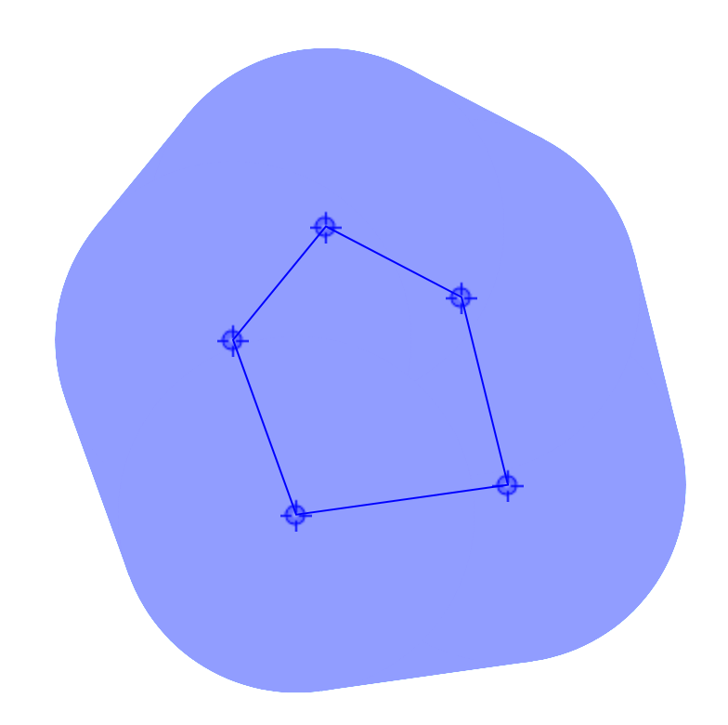
Remark: Third Definition of Steiner Point
Previous definitions generalize to any norm. In Euclidean space there is a third definition:
$s\left(K\right)=\lim_{r→∞}cg\left(K+B_{r}\right).$
Proof: Almost all mass is in the angled cones.
This shows agreement with primal definition.
$$s(K)$$

Slide 19
Remark: Properties of Steiner Point
A few beautiful properties (which we will not need):
1. $s\left(K+K′\right)=s\left(K\right)+s(K^{′})$. Follows from primal/dual definitions.
2. $s\left(K\right)$ commutes with isometries. Follows from primal definition.
3. In Euclidean space: continuity, 1 and 2 together uniquely characterize Steiner point.

Slide 20
Steiner Point is Hausdorff-Lipschitz
Classical Theorem:
$${\left|s\left(K\right)−s\left(K^{′}\right)\right|≤O\left(\sqrt{d}\right)⋅ ||h_{K}−h_{K^{′}}||}_{L^{∞}(B_{1})}.$$
Proof: With suboptimal factor $d$ via dual definition and triangle inequality:
$$\left|s\left(K\right)−s\left(K^{′}\right)\right|≤d⋅\int_{\left|θ\right|=1}{{|h}_{K}\left(θ\right)−h_{K^{′}}(θ)|dθ}≤d⋅{\left|\left|h_{K}−h_{K^{′}}\right|\right|}_{L^{∞}}.$$
To get $O\left(\sqrt{d}\right)$, note that the $θ$ directions cannot correlate much:
$${\left|s\left(K\right)−s\left(K^{′}\right)\right|=\max_{\left|u\right|=1}{〈u,s\left(K\right)−s\left(K^{′}\right)〉}≤d⋅{\max_{\left|u\right|=1}{\int_{\left|θ\right|=1}{\left|〈θ,u〉\right|}⋅{\left|\left|h_{K}−h_{k}^{′}\right|\right|}_{L^{∞}}^{ }dθ}.}_{ }}_{ }$$
Now just recall that $𝔼^{\left|θ\right|=1}[\left|〈θ,u〉\right|]≈d^{−1/2}$ for any unit vector u.

Slide 21
Chasing Nested Bodies with Steiner
Start with $K_{1}=B_{1}$ a unit ball, request sequence is $K_{1}⊇K_{2}⊇K_{3}….$ Try to minimize movement.
Nested condition is equivalent to support function decreasing:
$$h_{K_{1}}\left(θ\right)≥h_{K_{2}}\left(θ\right)≥h_{K_{3}}\left(θ\right)…$$
So again by triangle inequality:
$$\left|s\left(K_{t−1}\right)−s\left(K_{t}\right)\right|≤d⋅\int_{\left|θ\right|=1}{h_{K_{t−1}}\left(θ\right)−h_{K_{t}}\left(θ\right)dθ.}$$
Summing over $t$ for the total movement, sum telescopes. Hence the upper bound of d.
Can also show $O\left(\sqrt{d⋅\log\left(T\right)}\right)$: similar to $O(\sqrt{d} )$ Lipschitz from last slide. Only small sets of the sphere can correlate a lot.

Slide 22
The Work Function
To adapt Steiner point to general chasing convex bodies, we use the work function.
For general metrical task system problems:
The work function $W_{t}\left(x\right)$ is the minimum cost of any path servicing requests $K_{1},…K_{t}$ in order and ending at $x$. We can have $x∉K_{t}$ by moving to $x$ after servicing $K_{t}$.
The cost of OPT at time t is $\min_{x}(W_{t}\left(x\right))$.
$W_{t}\left(x\right)$ can be computed from$W_{t−1}$and $K_{t}$; this is how to solve for OPT with dynamic programming.
$W_{t}(x)$ is 1-Lipschitz.
$W_{t}(x)$ increases in time starting from $W_{0}\left(x\right)=d\left(x,x_{0}\right)=\left|x\right|.$
For CBC, $W_{t}(x)$ is convex. Recall the whole problem is convex – averaging paths lowers the cost.

Slide 23
Defining The Functional Steiner Point
Again the Steiner point is:
$$s\left(K_{t}\right)=\int_{\left|v\right|<1}{f_{K}\left(v\right)dv=d⋅\int_{\left|θ\right|=1}{h_{K}\left(θ\right)θ dθ}}$$
$$f_{K}\left(v\right)=argmax_{x∈K}⟨x,v⟩=∇h_{K}(θ), h_{K}\left(θ\right)=\max_{x∈K}\left\langle x,θ\right\rangle ={⟨f}_{K}\left(θ\right),θ⟩.$$
We extend the key identity $f_{K}=∇h_{K}$ to the function $W_{t}\left(⋅\right)$ using Fenchel duality.
Extreme point $f_{K}(v)$ becomes tangency point of $v$-slope hyperplane. Support function $h_{K}\left(v\right)$ becomes concave Fenchel dual $W_{t}^{∗}$of $W_{t}$.
$$s\left(W_{t}\right)=\int_{\left|v\right|<1}{f_{W_{t}}(v)dv=(−d)⋅\int_{\left|θ\right|=1}{W_{t}^{∗}\left(θ\right)θdθ}}$$
$$f_{W_{t}}(v)=\underset{x∈ℝ^{d}}{argmin}\left(W_{t}\left(x\right)−⟨x,v⟩\right){ ={\left(∇W_{t}\right)}^{−1}\left(v\right)=−∇W}_{t}^{∗}\left(v\right), W_{t}^{∗}\left(θ\right)=\min_{x∈ℝ^{d}}\left(W_{t}\left(x\right)−\left\langle x,θ\right\rangle \right)=W_{t}\left(f_{W_{t}}(θ)\right)−⟨f_{W_{t}}(θ),θ⟩.$$
$W_{t}^{∗}(θ)$ is the y-intercept of a $θ$–slope tangent plane to $W_{t}.$
$W_{t}^{∗}(θ)$ is finite for all $\left|θ\right|≤1$, concave, and increasing in time starting from $W_{0}^{∗}\left(θ\right)=0$.
$W_{t}^{∗}\left(0\right)=Cost\left(OPT\right).$

Slide 24
The Picture in 1 Dimension
To compute Functional Steiner Point in 1 dimension, intersect the tangent lines with slope +1, -1.
Equivalent to $s\left(W_{t}\right)=\frac{W_{t}^{∗}\left(1\right)−W_{t}^{∗}\left(−1\right)}{2}$.
These tangents move up over time. Horizontal movement
of $s(W_{t})$ is bounded by the tangent lines’ upward movement.
If the tangents are high, then $\min_{x}{W_{t}\left(x\right)=Cost\left(OPT_{t}\right) }$is high
because tangents are lower bounds for $W_{t}$. Hence this is 1-competitive.
$${y=W}_{t}(x)$$
$Cost_{t}\left(OPT\right)=\min_{x}{W_{t}(x)}$
is at least this high.
$$−W^{∗}(1)$$
$$s(W_{t})$$
$$W^{∗}(−1)$$

Slide 25
Functional Steiner Point is an Online Selector
$s\left(W_{t}\right)=\int_{\left|v\right|<1}{f_{W_{t}}(v)dv}; f_{W_{t}}(v)=\underset{x∈ℝ^{d}}{argmin}\left(W_{t}\left(x\right)−(x⋅v)\right){ ={\left(∇W_{t}\right)}^{−1}\left(v\right)=−∇W}_{t}^{∗}\left(v\right)$
Lemma: $s\left(W_{t}\right)∈K_{t}.$
By construction, $s\left(W_{t}\right)$ is a weighted average of $y$ with $\left|∇W_{t}\left(y\right)\right|<1$.
$\left|∇W_{t}\left(y\right)\right|<1$ implies $y∈K_{t}$.
If $y∉K_{t}$, the best path ending at $y$ came from $x_{t}∈K_{t}$. $∇W_{t}\left(y\right)$ is a unit vector pointing $y→x_{t}$.
Lemma follows by convexity of $K_{t}$.
$$y$$
$$x_{t}$$
$$K_{t}$$
$$x_{t−2}$$
$$x_{t−1}$$

Slide 26
Functional Steiner Point is $d$-Competitive
Recall: $s\left(W_{t}\right)=\left(−d\right)⋅\int_{\left|θ\right|=1}{W_{t}^{∗}\left(θ\right)θdθ}; W_{t}^{∗}\left(θ\right)=\min_{x∈ℝ^{d}}\left(W_{t}\left(x\right)−⟨θ,x⟩\right)$
Properties of work and dual work function:
1. $W_{t}^{∗}(θ)$ is concave, increasing in time from $W_{0}^{∗}\left(θ\right)=0$.
2. $\min_{x}{(W}_{t}(x))=Cost\left({OPT}_{t}\right).$
Therefore:
Again, concentration of measure gives the alternate bound $O\left(\sqrt{d⋅\log\left(T\right)}\right)$.
$$\sum_{t≤T}{\left|s\left(W_{t}\right)−s\left(W_{t−1}\right)\right|}$$
$$≤$$
$$d⋅\sum_{t≤T}{ }\int_{\left|θ\right|=1}{|W_{t}^{∗}\left(θ\right)−W_{t−1}^{∗}\left(θ\right)|dθ}$$
$$d⋅\int_{\left|θ\right|=1}{W_{t}^{∗}\left(θ\right)dθ}$$
$$=$$
$$≤$$
$$d⋅W_{t}^{∗}\left(0\right)$$
$$=d⋅\min_{x}{(W}_{t}(x))$$
$$=d⋅Cost\left({OPT}_{t}\right) ∎$$

Slide 27
Chasing Convex Functions Directly
Functional Steiner Point $x_{t}=s\left(W_{t}\right)$ works directly to chase convex functions. No reduction needed.
Movement $≤d⋅Cost\left({OPT}_{t}\right)$, service cost $\sum_{t≤T}{f_{t}(x_{t}) }≤Cost\left({OPT}_{t}\right)$. Overall d+1 competitive.

Slide 28
Functional Steiner Point via Level Sets
Consider a (convex) level set $Ω_{t,R}=\left\{x:{ W}_{t}\left(x\right)≤R\right\}$ of $W_{t}$. As a convex set it has a Steiner point $s(Ω_{t,R})$.
Theorem: for $R$ large enough that ${K_{t}⊆Ω}_{t,R}$, we have $s\left(W_{t}\right)=s(Ω_{t,R})$.
The dual definition for $s\left(W_{t}\right)$ uses tangent hyperplanes to $graph\left(W_{t}\right)$with slopes $\left|θ\right|=1$.
These hyperplanes are tangent on $∂Ω_{t,R}$, at tangency points $f_{W_{t}}(θ)$satisfying $W_{t}\left(f_{W_{t}}(θ)\right)=R.$
Now the $W_{t}$ term in the definition cancels by symmetry:
$$s\left(W_{t}\right)=\left(−d\right)⋅\int_{\left|θ\right|=1}{W_{t}^{∗}\left(θ\right)⋅θdθ}=\left(−d\right)⋅\int_{\left|θ\right|=1}{{(W}_{t}\left(f_{W_{t}}(θ)\right)−f_{W_{t}}(θ)⋅θ) θdθ}=\left(−d\right)⋅\int_{\left|θ\right|=1}{\left(R−f_{W_{t}}(θ)⋅θ\right)θdθ=d⋅\int_{\left|θ\right|=1}{h_{Ω_{t,R}}(}θ) θ dθ.}$$
Actually ${s(Ω}_{t,R})∈K_{t}$ for any $R≥Cost(OPT_{t})$. [AGGT 19] uses $R=2^{⌈\log_{2}{Cost\left(OPT_{t}\right)}⌉}$ but their proof is different.

Slide 29
Other Norms
(Functional) Steiner point works in any normed space.
In general, integrate over $v,θ$ in the dual ball/sphere.
Use cone measure on sphere: $\frac{v}{\left|\left|v\right|\right|}$ for random $\left|v\right|<1.$
Theorem: Functional Steiner Point is $d$-competitive for chasing convex bodies in any norm.
Proof is exactly the same.
But $O\left(\sqrt{d⋅\log\left(T\right)}\right)$ bound is specific to $ℓ_{2}$.

Slide 30
Open Questions and Follow-Ups
Competitive ratio $d$ is tight for $ℓ_{d}^{∞}$. More precision for other norms? Only lower bounds are from nested case.
For $p≥2,$tight up to $\sqrt{\log\left(T\right)}$. For $p<2$, polynomial gap even for $T=poly\left(d\right)$.
More specific/general problems:
[Argue-Gupta-Guruganesh 20]: $O(\sqrt{κ})$-competitive alg for $κ−$strongly convex functions. Lower bound $Ω\left(κ^{1/3}\right).$
[Bubeck-Rabani-S 20]: If $min(d,k)>1$, impossible to chase convex bodies with $k$ servers competitively.
Reduction to k-server for nice cost functions, including strongly convex.
[Bubeck-Li-Luo-Wei 19] gives a blackbox application to multi-armed bandit learning. More connections to discover?

Slide 31
References
[ABNPSS 16] Antonios Antoniadis, Neal Barcelo, Michael Hugent, Kirk Pruhs, Kevin Schewior, Michele Scquizzato. Chasing convex bodies and functions. LATIN 2016.
[ABCGL 18] C.J. Argue, Sébastien Bubeck, Michael B. Cohen, Anupam Gupta, and Yin Tat Lee. A nearly-linear bound for chasing nested convex bodies. SODA 2019.
[AGGT 19] C.J. Argue, Anupam Gupta, Guru Guruganesh, Ziye Tang. Chasing convex bodies with linear competitive ratio. SODA 2020.
[CGW 18] Niangjun Chen, Gautam Goel, Adam Wierman. Smoothed Online Convex Optimization in High Dimensions via Online Balanced Descent. 2018
[BBEKU 18] Nikhil Bansal, Martin Bohm, Marek Elias, Grigorios Koumoutsos, Seeun William Umboh. Nested convex bodies are chaseable. SODA, 2018.
[BKLLS 18] Sébastien Bubeck, Bo’az Klartag, Yin Tat Lee, Yuanzhi Li, Mark Sellke. Chasing nested convex bodies nearly optimally. SODA 2020.
[BLLS 18] Sébastien Bubeck, Yin Tat Lee, Yuanzhi Li, Mark Sellke. Competitively chasing convex bodies. STOC 2019.
[BRS 18] Sébastien Bubeck, Yuval Rabani, Mark Sellke . Online multi-server convex chasing and optimization. SODA 2021.
[FL 93] Joel Friedman, Nat Linial. On convex body chasing. Discrete & Computational Geometry 1993.
[GW 19] Gautam Goel, Adam Wierman. An online algorithm for smoothed regression and LQG control. PMLR 2019.
[PY 89] Krzysztof Przesławski and David Yost. Continuity properties of selectors and Michael's theorem. Michigan Mathematics Journal 1989.
[Sch 71] Rolf Schneider. On Steiner points of convex bodies. Israel J Math 1971.
[S 19] Mark Sellke. Chasing convex bodies optimally. SODA 2020.
[Ste 1840] Jakob Steiner. Von dem krümmungs-schwerpuncte ebener curven. Journal für die reine und angewandte Mathematik, 21:33–63, 1840.

Slide 32
Thank you!

Slide 33
Bonus: Steiner Point Minimizes Euclidean Lipschitz Constant Among Selectors
In Euclidean space, the Steiner point is highly symmetric: it commutes with isometry and Minkowski sum: $K_{1}+K_{2}=\{k_{1}+k_{2}: k_{1}∈K_{1},k_{2}∈K_{2}\}.$
Given an arbitrary selector S, we can symmetrize S to have the same properties. For example:
$$\hat{S}\left(K\right)=𝔼\left[g^{−1}\left(S\left(g\left(K\right)\right)\right)\right].$$
Here $g$ is a uniformly random rotation. Because $gh$ is also uniformly random for fixed $h$:
$$\hat{S}\left(h(K)\right)=𝔼\left[g^{−1}\left(S\left(gh\left(K\right)\right)\right)\right]=h𝔼\left[{(gh)}^{−1}\left(S\left(gh\left(K\right)\right)\right)\right]=h\left(\hat{S}\left(K\right)\right).$$
Similar procedure to make it also commute with other isometries and Minkowski sum.

Slide 34
Bonus: Steiner Point Minimizes Euclidean Lipschitz Constant Among Selectors
Theorem [Sch 71]: any continuous selector commuting with isometry and Minkowski sum is exactly the Steiner point.
Symmetrization decreases the Lipschitz constant, therefore Steiner point has the exact minimum.
A similar argument shows Steiner point gets the exact optimal constant $c\left(d,T\right)$ with
$∑||s\left(K_{t}\right)−s(K_{t−1}||≤c\left(d,T\right)⋅d_{H}(K_{1},K_{T})$
for any sequence of nested convex bodies $K_{1}⊇K_{2}⊇…⊇K_{T}$.
Argument for T=1 from [Przesławski-Yost 89].

Slide 35
Bonus: Steiner Point Minimizes Euclidean Lipschitz Constant Among Selectors
But there is no uniformly random isometry! Not to mention a uniformly random convex body…
Solution: use an invariant mean to symmetrize.
Lets you average ANY bounded measurable function over an amenable group such as the isometry group of $ℝ^{d}$. It even works for the semigroup of convex sets under Minkowski sum.
Caveats: invariant means are only finitely additive. The construction requires axiom of choice/ultrafilters. (But we are proving a lower bound, so no need to compute it.)

